Slide 1

.NET Architectural Components
.NET / Microsoft Dynamics 365

Slide 2
A .NET app is developed for and runs in one or more implementations of .NET (.NET Framework, .NET Core, or Mono). There is an API specification common to all implementations of .NET. The .NET Standard.
https://docs.microsoft.com/en-us/dotnet/standard/components#applicable-standards

Slide 3
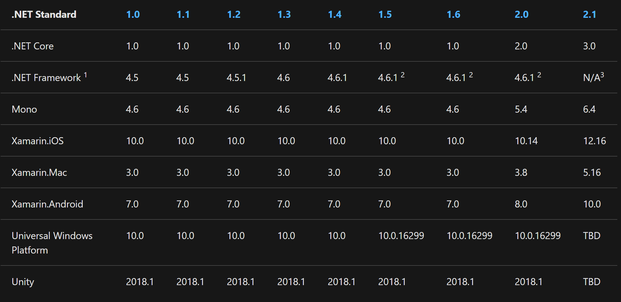
.NET Standard https://docs.microsoft.com/en-us/dotnet/standard/components#net-standard https://docs.microsoft.com/en-us/dotnet/standard/net-standard#net-implementation-support
The .NET Standard is a specification of .NET APIs that make up a uniform set of contracts that you compile your code against. This enables portability across different .NET implementations, allowing your code to run everywhere.
The .NET Standard is also a target framework. If your code targets a version of the .NET Standard, it can run on any .NET implementation which supports that version of the .NET Standard.

Slide 4
.NET Standard https://docs.microsoft.com/en-us/dotnet/standard/net-standard#net-implementation-support
To find the highest version of .NET Standard that you can target, do the following steps:
Find the row that indicates the .NET implementation you want to run on.
Find the column in that row that indicates your version starting from right to left.
The column header indicates the .NET Standard version that your target supports. You may also target any lower .NET Standard version. Higher .NET Standard versions will also support your implementation.
Repeat this process for each platform you want to target. If you have more than one target platform, you should pick the smaller version among them. For example, if you want to run on .NET Framework 4.5 and .NET Core 1.0, the highest .NET Standard version you can use is .NET Standard 1.1.

Slide 5
.NET Standard - Facts https://docs.microsoft.com/en-us/dotnet/standard/net-standard https://en.wikipedia.org/wiki/NuGet
.NET Standard versions are additive. They are logically concentric circles: higher versions incorporate all APIs from previous versions (no ‘breaking’ changes between versions).
The higher the .NET Standard version, the more APIs are available to you.
The lower the version, the more platforms implement it.
Immutable: Once finalized, .NET Standard versions are frozen.
The primary distribution vehicle for the .NET Standard reference assemblies is NuGet packages.
The NETStandard.Library metapackage references the complete set of NuGet packages that define .NET Standard.
The most common way to target netstandard is by referencing this metapackage.
It describes and provides access to the ~40 .NET libraries and associated APIs that define .NET Standard.
.NET Standard is the replacement for Portable Class Libraries (PCL).

Slide 6
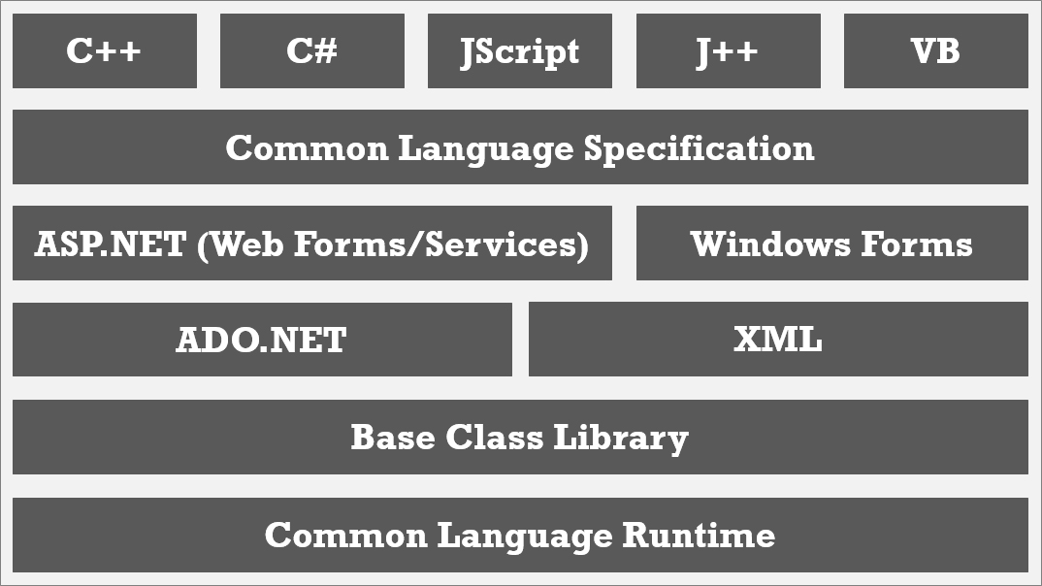
.NET Framework (old) http://thedotnetproject.blogspot.com/2015/11/the-net-framework.html
At the bottom of the .Net Framework structure is Common Language Runtime (CLR)which handles code execution.

Slide 7
.NET Framework http://thedotnetproject.blogspot.com/2015/11/the-net-framework.html
Above the CLR layer is the .NET Base Class Library which contains ‘runtime libraries’ that support common functions like file reading and writing, XML document manipulation, exception handling, application globalization, network communication, threading and reflection, which makes the programmer's job easier.

Slide 8
.NET Framework http://thedotnetproject.blogspot.com/2015/11/the-net-framework.html
ADO.NET (library) and XML support tasks related to data access, parsing, manipulation and generating XML.

Slide 9
.NET Framework http://thedotnetproject.blogspot.com/2015/11/the-net-framework.html
ASP.NET and Windows Forms build robust web applications and standard Windows applications as well as develop and consume web services.

Slide 10
.NET Framework http://thedotnetproject.blogspot.com/2015/11/the-net-framework.html
Common Language Specification (CLS) then facilitates interoperability between languages. It defines the reasonable subset of Common Type System (CTS), the shared data type that serves a great role in cross-language integration. The flexibility of CTS make many languages adapt to .NET platform.

Slide 11

Current .NET Implementations https://docs.microsoft.com/en-us/dotnet/standard/components#universal-windows-platform-uwp
There are four primary .NET implementations that Microsoft actively develops/maintains:
.NET Core
.NET Framework
Mono
UWP.
Each implementation of .NET includes the following components:
One or more runtimes.
CLR for .NET Framework,
CoreCLR & CoreRT for .NET Core.
A class library implementing .NET Standard (possibly additional APIs).
.NET Framework Base Class Library,
.NET Core Base Class Library.
(Optional) One or more application frameworks. Included in the .NET Framework and .NET Core are:
ASP.NET,
Windows Forms, and
Windows Presentation Foundation (WPF)
Some development tools are shared among multiple implementations.

Slide 12
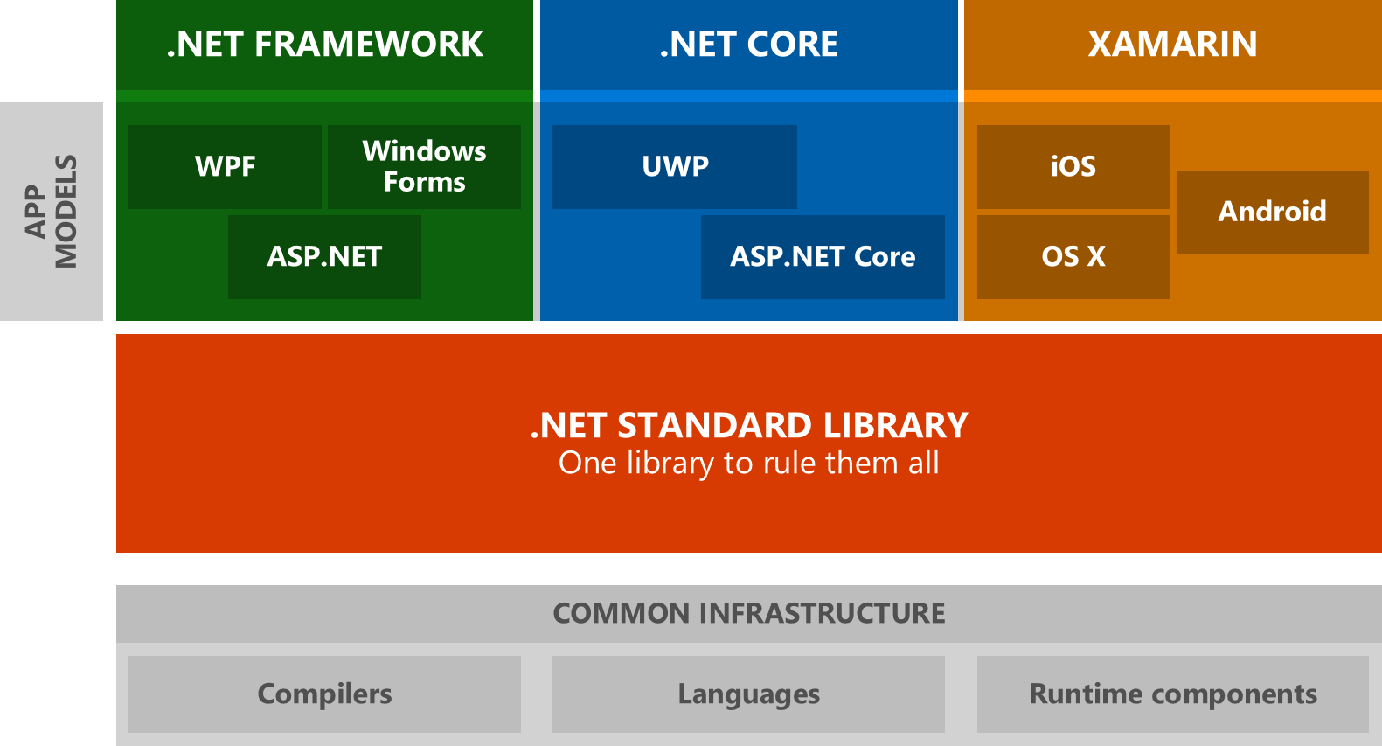


.NET Framework(newer) https://docs.microsoft.com/en-us/dotnet/standard/components#net-framework
The.NET Framework is the original .NET implementation that has existed since 2002.
Versions 4.5 and later implement the .NET Standard
It contains additional Windows-specific APIs. Like APIs for:
Windows desktop development with Windows Forms and WPF.
The .NET Framework is optimized for building Windows desktop applications.
.NET Framework Guide

Slide 13
.NET Core https://docs.microsoft.com/en-us/dotnet/standard/components#net-core
Starting in 2016, .NET Core is a cross-platform implementation of .NET, designed to handle server and cloud workloads at scale.
It runs on Windows, macOS, and Linux.
It implements the .NET Standard.
Code that targets .NET Standard can run on:
.NET Core.
ASP.NET Core,
Windows Forms, and
Windows Presentation Foundation (WPF)
.NET Core Guide

Slide 14
Mono https://docs.microsoft.com/en-us/dotnet/standard/components#mono https://www.mono-project.com/docs/about-mono/
Mono is focused primarily on a small footprint.
It’s mainly used when a small runtime is required.
Mono powers Xamarin applications on
Mono powers games built using the Unity engine.
It supports all .NET Standard versions.
It’s used to run .NET applications that rely on Unix.
Is used with a Just-In-Time compiler.
Features a full static compiler (ahead-of-time compilation) used on platforms like iOS.
Android | macOS | iOS | tvOS | watchOS

Slide 15
UWP – Universal Windows Platform https://docs.microsoft.com/en-us/dotnet/standard/components#mono
UWP is an implementation of .NET that is used for building, touch-enabled Windows apps and software for the IoT.
It's designed to unify different devices including PCs, tablets, phablets, phones, and Xbox.
UWP provides:
a centralized app store,
an execution environment (AppContainer)
a set of Windows APIs.
Apps can be written in C++, C#, Visual Basic, and JavaScript.
When using C# and Visual Basic, the .NET APIs are provided by .NET Core.

Slide 16
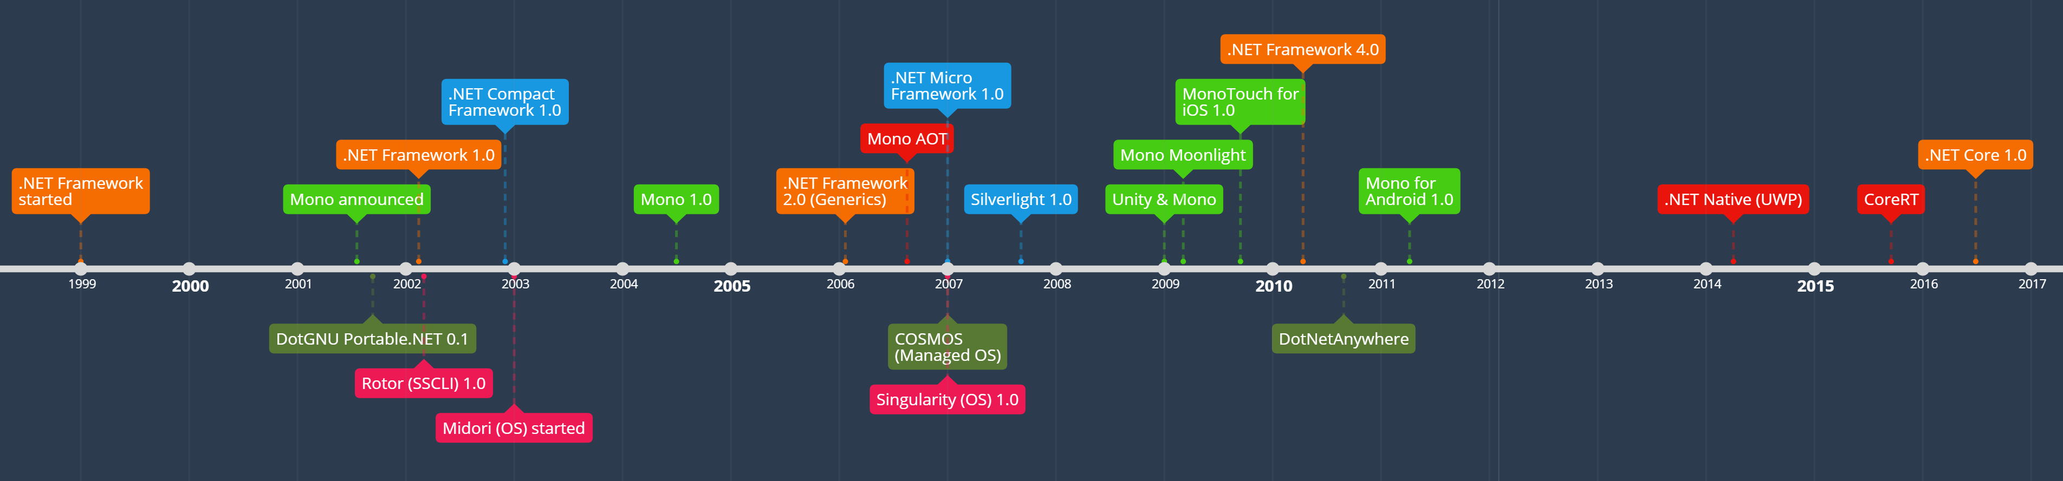
.NET Runtimes https://docs.microsoft.com/en-us/dotnet/standard/components#net-runtimes https://mattwarren.org/2018/10/02/A-History-of-.NET-Runtimes/
A ‘runtime’ is the execution environment for a managed program. The OS is part of the ‘runtime environment’ but is NOT part of the ‘.NET runtime’. Here are some examples of ‘.NET runtimes’:
Common Language Runtime (CLR) for the .NET Framework | .NET Native for Universal Windows Platform
Core Common Language Runtime (CoreCLR) for .NET Core | The Mono runtime for Xamarin.iOS, Xamarin.Android, Xamarin.Mac, and the Mono desktop framework

Slide 17

Xamarin https://docs.microsoft.com/en-us/xamarin/get-started/what-is-xamarin
Xamarin is an open-source platform for building applications for iOS, Android, and Windows with .NET.
Xamarin is an abstraction layer that manages communication of shared code with underlying platform code.
Xamarin runs in a managed environment that provides memory allocation and garbage collection.
Xamarin enables developers to share an average of 90% of their application across platforms.
Xamarin applications can be written on PC or Mac and compile into native application packages

Slide 18
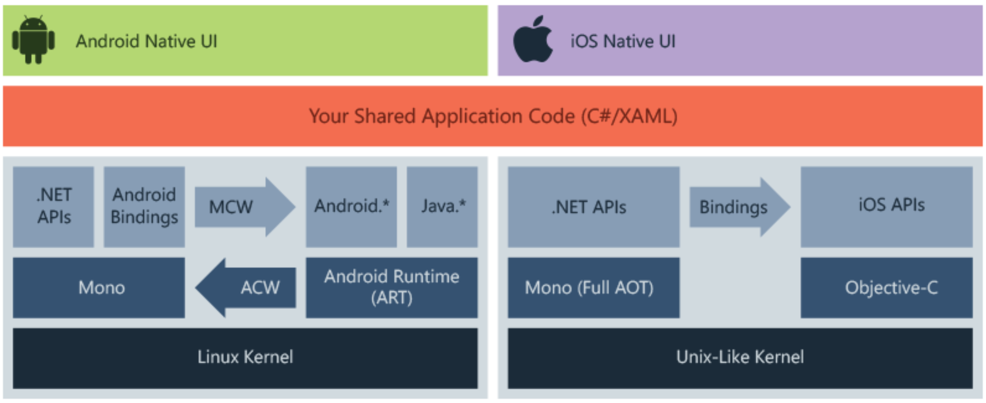
Xamarin https://docs.microsoft.com/en-us/xamarin/get-started/what-is-xamarin
Xamarin allows you to create native UI on each platform and write business logic in C# that is shared across platforms. In most cases, 80% of application code is sharable using Xamarin.
Xamarin is built on top of Mono. Mono runs on most platforms including Linux, Unix, FreeBSD, and macOS. The Mono execution environment automatically handles tasks such as memory allocation, garbage collection and interoperability with underlying platforms.
Xamarin is for developers with the following goals:
Share code, test and business logic across platforms.
Write cross-platform applications in C# with Visual Studio.

Slide 19
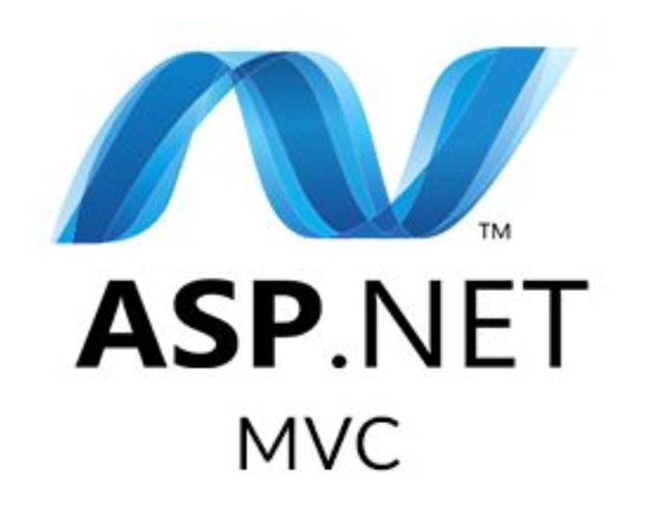
ASP.NET (use ASP.NET Core) https://docs.microsoft.com/en-us/aspnet/overview
ASP.NET is a web framework for building websites and web applications (HTML, CSS, and JavaScript), for creating Web APIs, and for using real-time technologies like Web Sockets. ASP means Active Server Pages.
ASP.NET offers three frameworks (Web Forms, MVC, Web Pages) for creating web applications. Each framework targets a different development style. The one you choose depends on a combination of your knowledge, skills, and development experience, the type of application you're creating, and the development approach you're comfortable with.

Slide 20

ASP.NET https://docs.microsoft.com/en-us/aspnet/overview
 | If you have experience in. | Development style | Expertise
Web Forms | Win Forms, WPF, .NET | Rapid development using a library of controls that encapsulate HTML markup | Mid-Level, Advanced RAD
MVC | Ruby on Rails, .NET | Full control over HTML markup, code and markup separated, and easy to write tests. The best choice for mobile and single-page applications (SPA). | Mid-Level, Advanced
Web Pages | Classic ASP, PHP | HTML markup and your code together in the same file | New, Mid-Level

Slide 21
ASP.NET MVC https://docs.microsoft.com/en-us/aspnet/overview#mvc
ASP.NET MVC gives you a patterns-based way to build dynamic websites that enables a clean separation of concerns and that gives you control over markup for agile development.
ASP.NET MVC includes many features that enable fast, TDD-friendly (Test Driven Development) development for creating applications that use the latest web standards.

